Slide 1

BANKING ANALYTICS -P877
Presented By Group -4

Slide 2

MEET MY TEAM MEMBERS
Nina Fiona Dcosta
Yelavarthi Suchitra
Kunal Panwar
ShivamSatish Battinwar
Poranki Mohan Sai

Slide 3

01
Introduction
AGENDA
02
Purpose
03
Scope
04
KPI”S
05
Insights

Slide 4

INTRODUCTION
Our presentation today will walk you through a detailed examination of the data, insightful observations, and actionable recommendations for stakeholders in the financial industry. We believe that data-driven insights are instrumental in making informed decisions, reducing risks, and ensuring the overall health and sustainability of the banking sector.

Slide 5

SCOPE
The scope of this analysis encompasses a multifaceted exploration of loan data, including year-wise loan amounts, grade and sub-grade-wise revolving balances, total payments based on verification status, state-wise and month-wise loan status, and the relationship between home ownership and last payment dates. By scrutinizing these KPIs, we aim to uncover trends, patterns, and correlations that can drive better lending practices, risk management, and financial planning.

Slide 6

OVERVIEW
As per the data,We are using different types of categories to analyze the data and find out the verified and non-verified customer based on year and interest. How payment mode is effected in loan section. Methodology: The Research conducted a quantitative analysis on data and data set gotten from EXCELR.

Slide 7




TOOLS
Excel
Project management
tools
Power Bi
Tableau
My Sql

Slide 8
INCEPTION OF DATA
Total loans
65,500
Total Funded amount
732.8M
Avg Interest Rate
12.02%
Loan tenure
36&60 months
Net Transaction amount
318.12k

Slide 9


Slide 10
KPI’S 01
Our analysis suggests that branch
‘Sangrur” has the highest total revenue while other branches has less revenue.
Excel

Slide 11
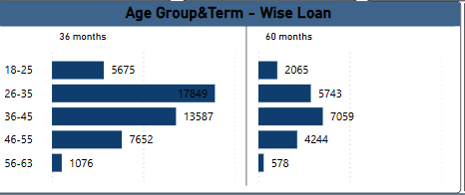
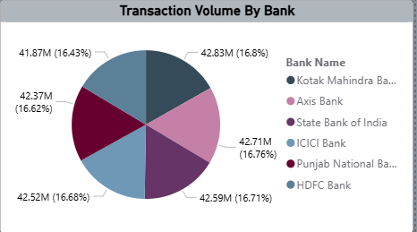
KPI’S 02
In this analysis as age group(26-35) from 36 months term has majority of loans ,while in 60 months term age group (36-45) has majority of loans.
This analysis states that Axis bank has the more transactions while compare to the other banks,This graph shows that there is minor difference of transaction between the banks.
Power Bi

Slide 12
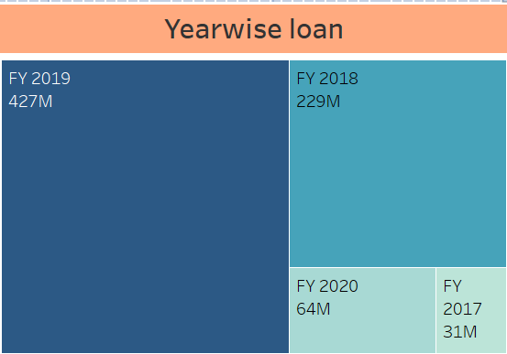
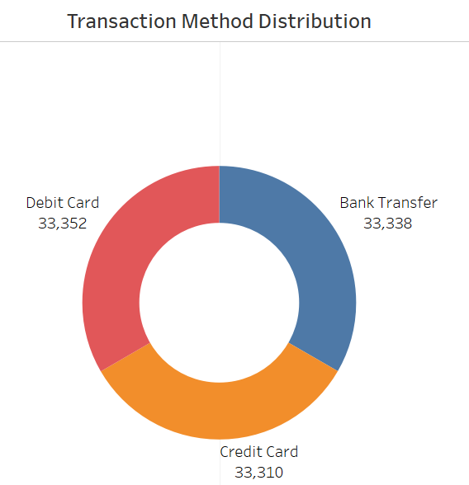
KPI’S 03
Our Analysis Suggests that The Total Loan amount was increased year by year. & 2019 boosts the highest loan amount while 2017 reflects the lowest amount .
In this analysis suggests that debit card transaction was high when compared to bank and credit card transaction
Tableau

Slide 13
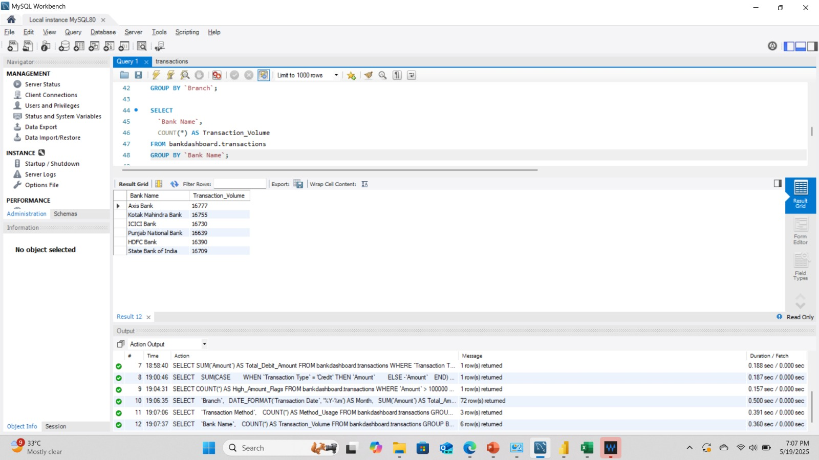
KPI’S 04
We provide 6 banks, where axis bank held the highest transaction volume since then.
My SQL

Slide 14


Slide 15
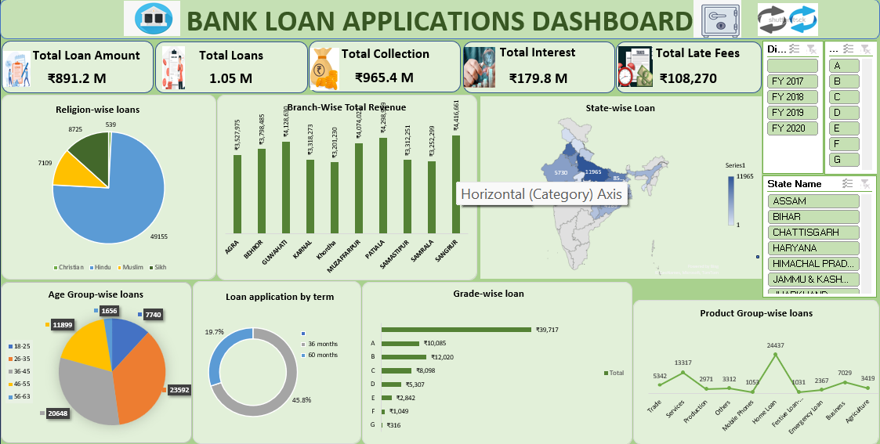
EXCEL DASHBOARD

Slide 16
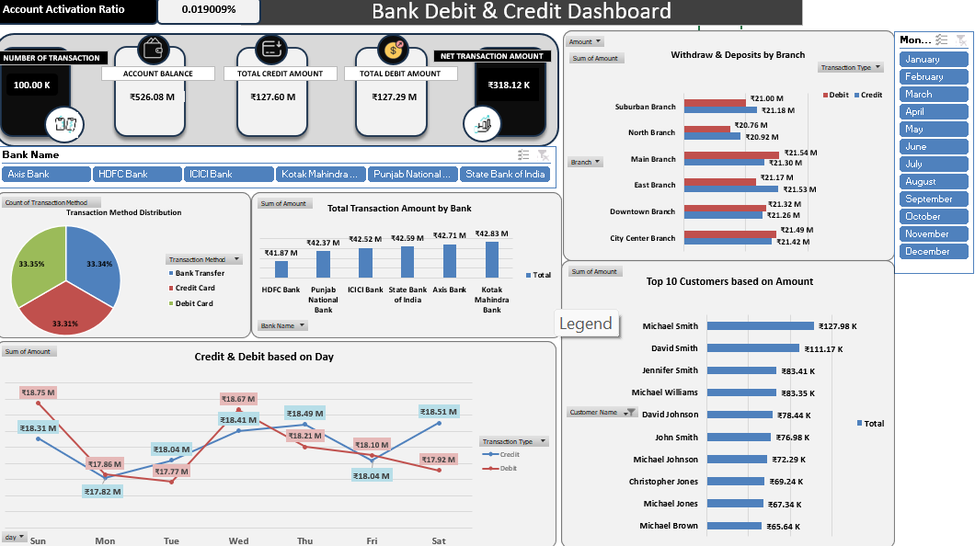

Slide 17
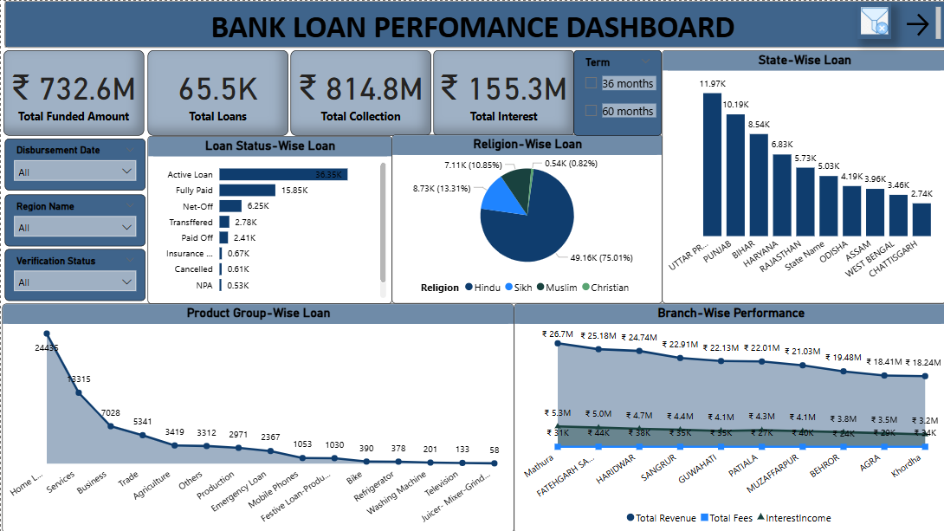
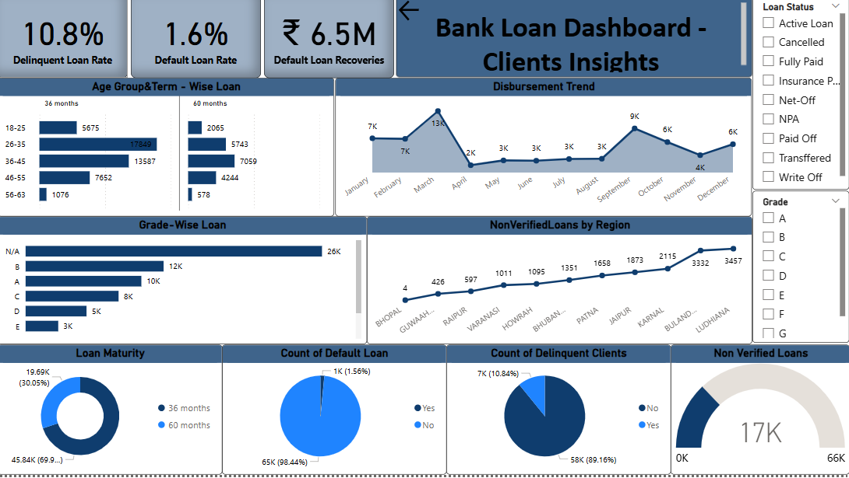
POWER BI DASHBOARD

Slide 18
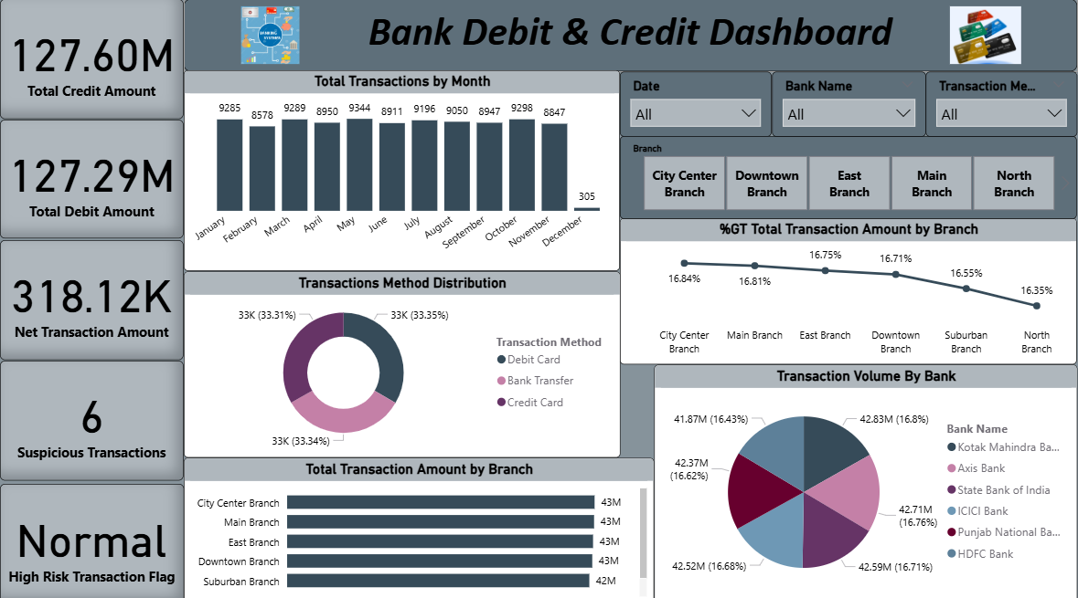

Slide 19
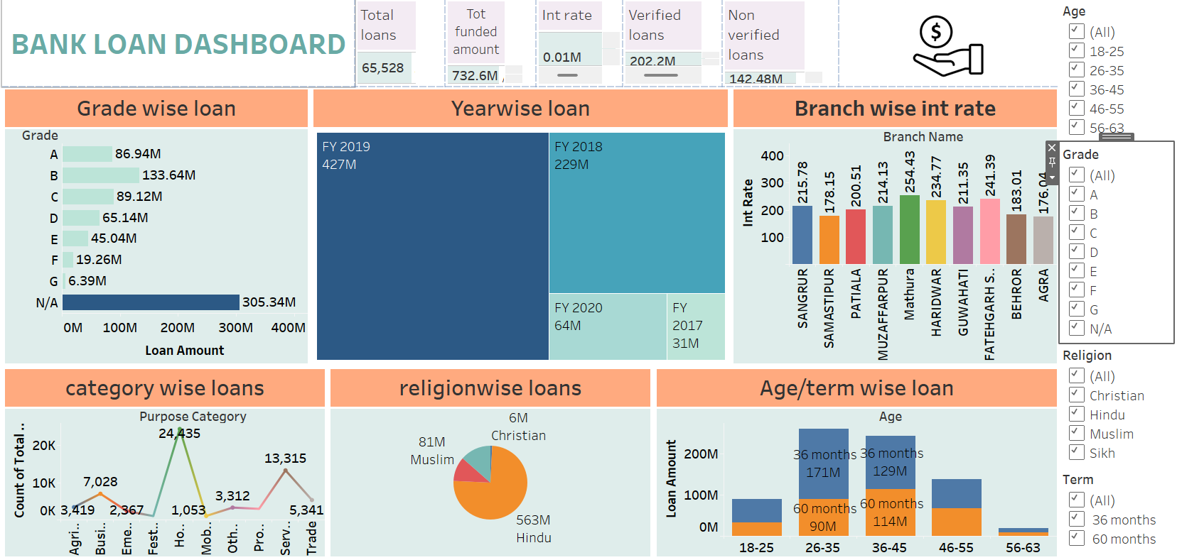
Tableau dashboard

Slide 20
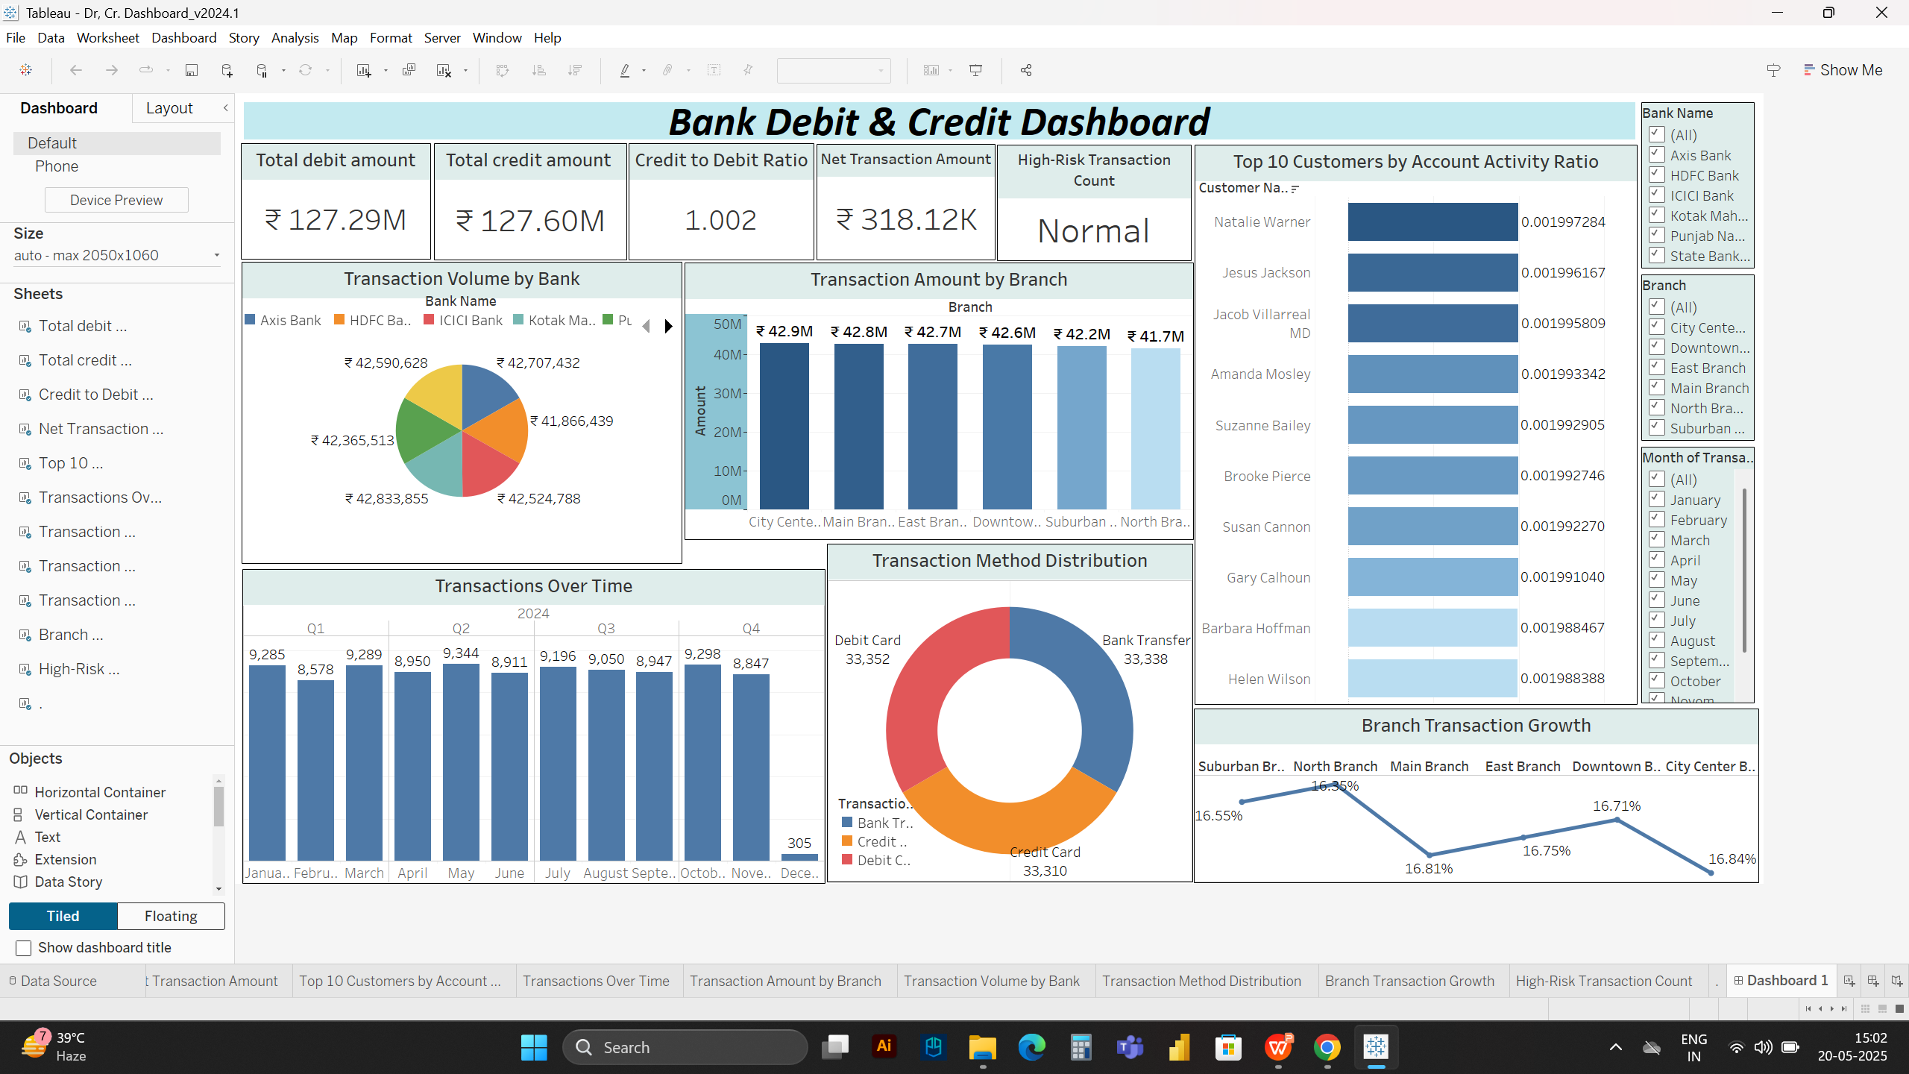

Slide 21
MYSQL DASHBOARD
# SELECT SUM(Amount) AS Total_Debit_Amount FROM bankdashboard.transactions WHERE Transaction Type = 'Debit';
#SELECT SUM(CASE WHEN Transaction Type = 'Credit' THEN Amount ELSE -Amount END) AS Net_Transaction_Amount FROM bankdashboard.transactions;
#SELECT SUM(`Funded Amount`) AS Total_Loan_Amount_FundedFROM Loan;
#SELECT round(SUM(`Total Rec Prncp`) + SUM(`Total Rrec int`),2) AS Total_CollectionFROM Loan;

Slide 22


INSIGHT’S
The increase in loan amounts signifies a growing credit demand. Growing loan amounts indicate borrowers' increased willingness to seek financing for various needs.
Mathura holds the highest revolving balance, amounting to 26..7 million.
This data underscores the importance of verification in facilitating higher payment volumes and potentially enhancing trust and security in financial transactions.
The data highlights the significance of mortgage loans in the housing market due to their higher loan amounts compared to other categories. Analyzing the last payment date aids in assessing payment timeliness and potential repayment patterns within each home ownership category.

Slide 23


